Slide 1
Thermal Relaxation Errors
Meeting with Professor Schnetzer and Rikab
August 17, 2020

Slide 2
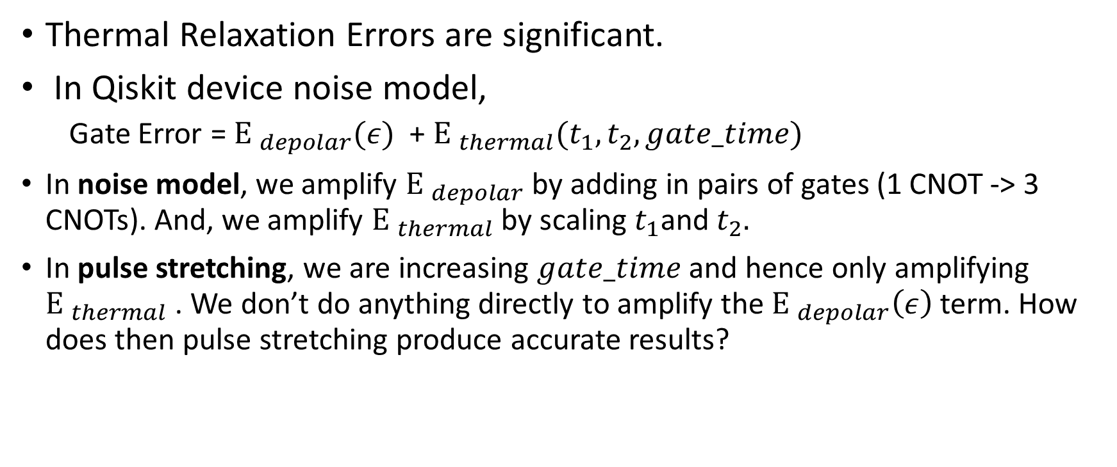
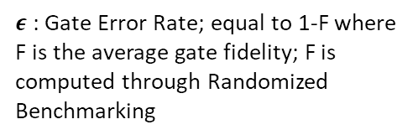
Talking Points
Thermal Relaxation Errors are significant.
In Qiskit device noise model,
Gate Error = ${Ε }_{depolar}(ε)$ + ${Ε }_{thermal}(t_{1},t_{2}, gate_time)$
In noise model, we amplify ${Ε }_{depolar}$ by adding in pairs of gates (1 CNOT -> 3 CNOTs). And, we amplify ${Ε }_{thermal}$by scaling $t_{1}$and $t_{2}.$
In pulse stretching, we are increasing $gate_time$ and hence only amplifying ${Ε }_{thermal}$. We don’t do anything directly to amplify the ${Ε }_{depolar}\left(ε\right)$term. How does then pulse stretching produce accurate results?
$ε$: Gate Error Rate; equal to 1-F where F is the average gate fidelity; F is computed through Randomized Benchmarking

Slide 3
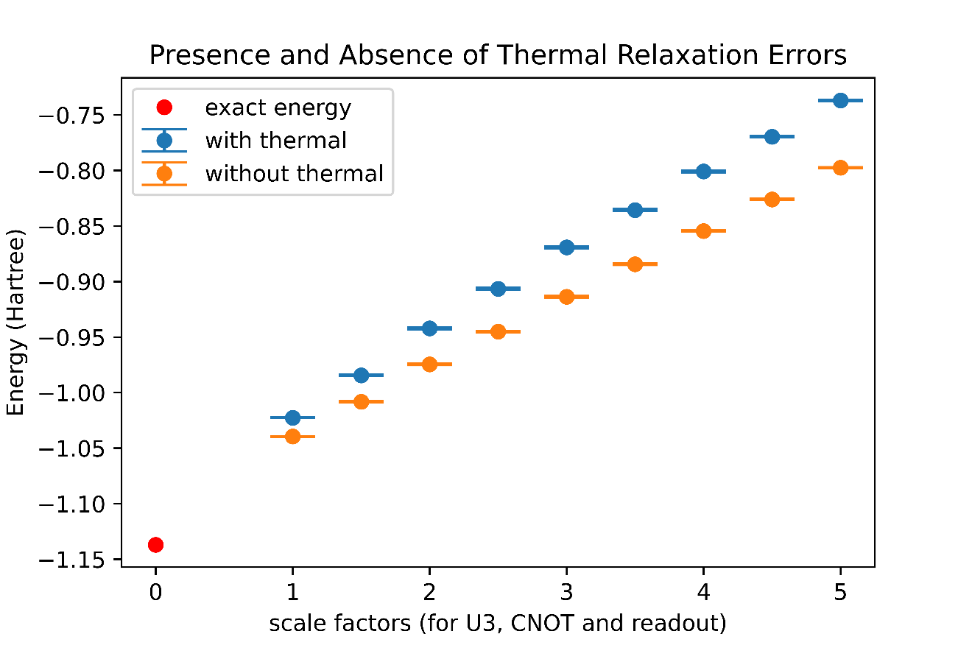
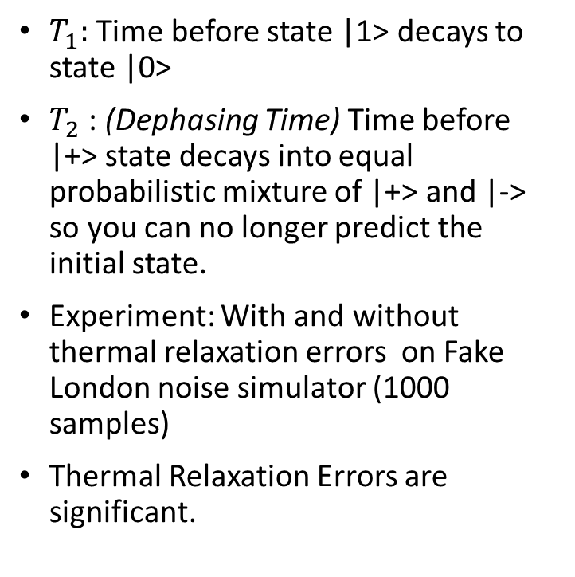
Thermal Relaxation Errors
$T_{1}:$ Time before state |1> decays to state |0>
$T_{2}$ : (Dephasing Time) Time before |+> state decays into equal probabilistic mixture of |+> and |-> so you can no longer predict the initial state.
Experiment: With and without thermal relaxation errors on Fake London noise simulator (1000 samples)
Thermal Relaxation Errors are significant.

Slide 4
Gate Errors on Qiskit Noise Models
How implemented?
Gate Error = Depolarizing Error + Thermal Relaxation Error
Assumptions:
All non-relaxation errors are depolarizing
Now thermal relaxation errors should occur if the qubits are “idle” i.e. while no gates are acting on the qubits. However, in the device noise models generated by Qiskit, relaxation errors only occur while qubits are being acted upon by gates.
Ignores non-local errors such as ‘cross-talk’. (This includes readout error correlation between qubits)

Slide 5
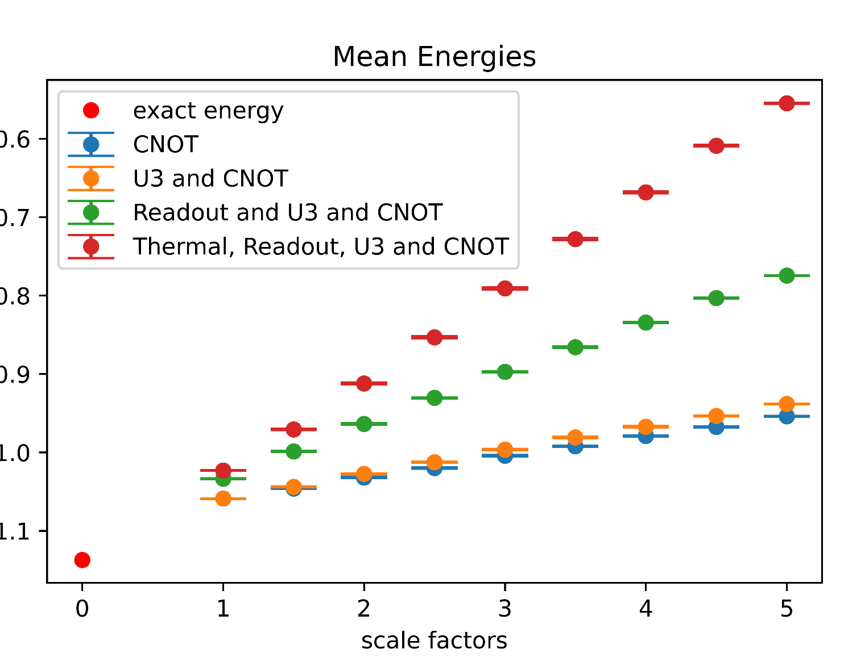
Amplifying one error at a time (1)
FakeLondon Noise Model (1000 samples)

Slide 6
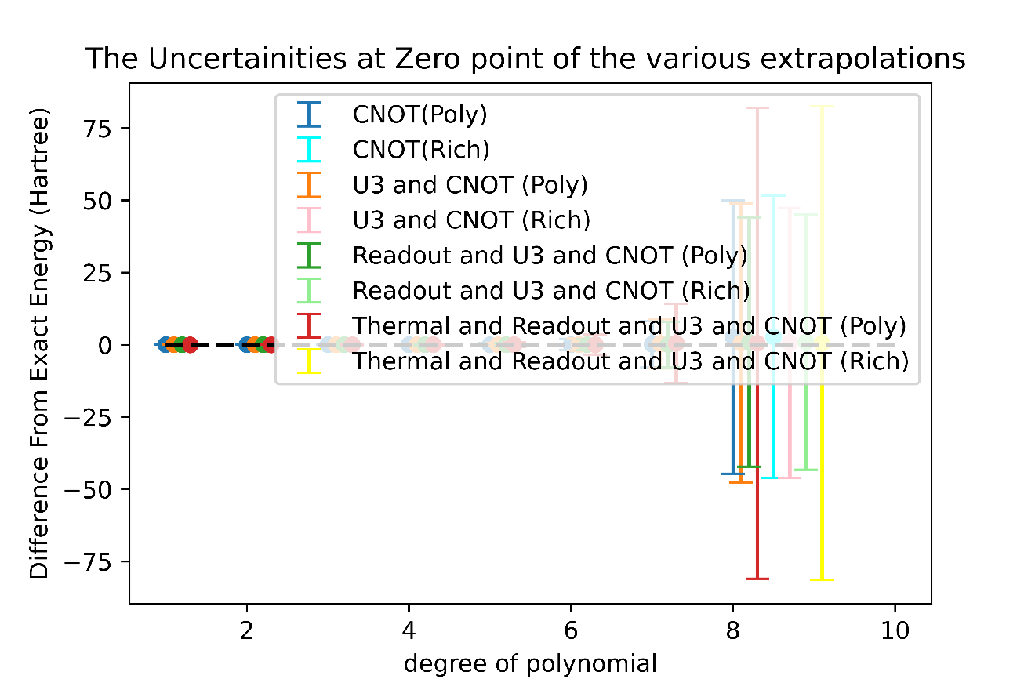
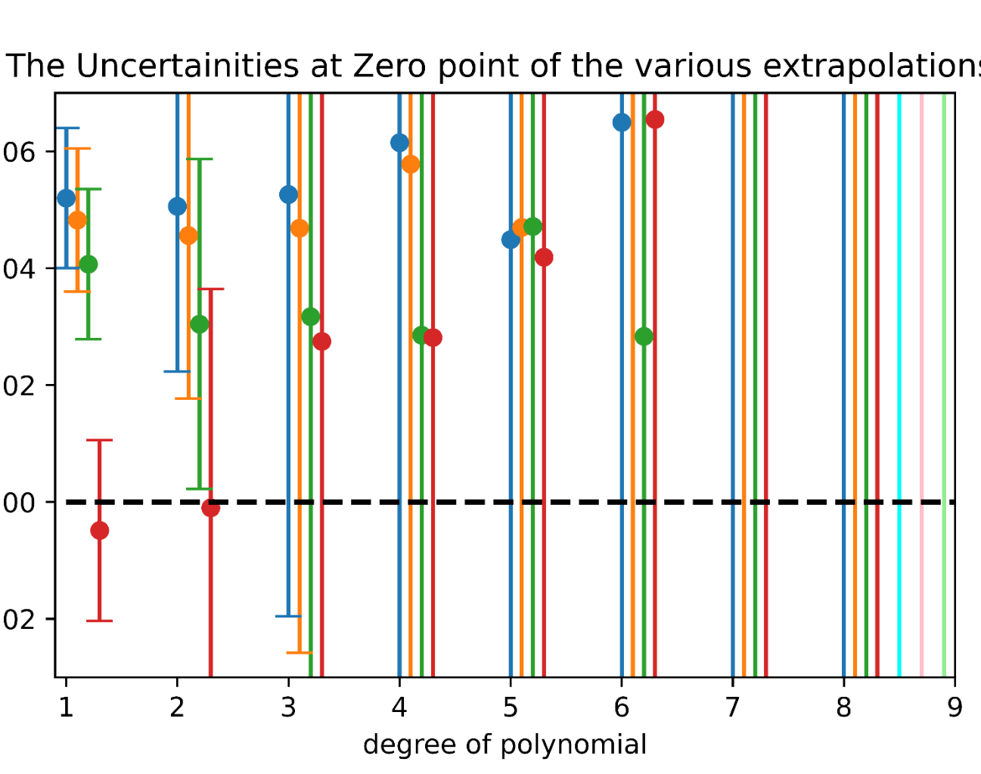
Amplifying one error at a time (2)
FakeLondon Noise Model (1000 samples)
Bottom Plot
(On the Y axis, ‘-0.’ is cut out )

Slide 7
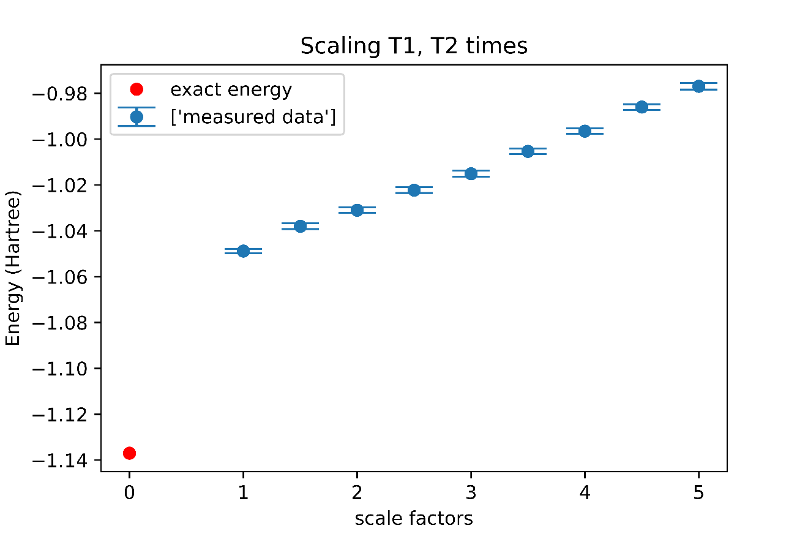
Amplifying only Thermal Relaxation Errors
Ignoring amplification of U3, CNOT and readout errors
Since only thermal relaxation errors are amplified, this experiment is similar to stretching gate pulses on the noise model (not actual quantum computer)
Result: Just amplifying thermal relaxation errors does not amplify the overall error rate on the noise model.
Data From FakeLondon Noise Model (100 samples)

Slide 8
Loose Ends from Readout Error Experiments
Looking at Correlation between Qubits, Doing the experiments from last week on real device

Slide 9
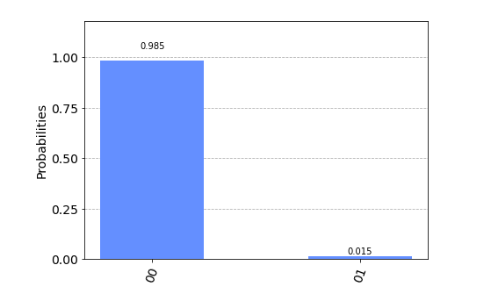
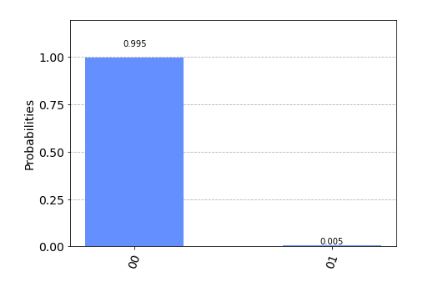
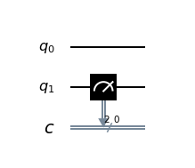
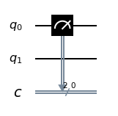
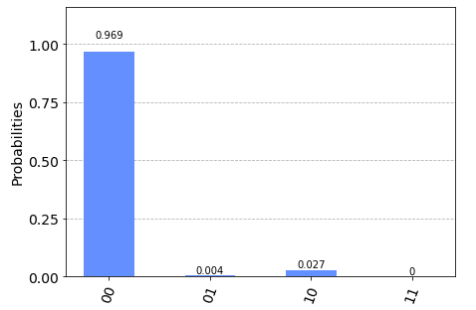
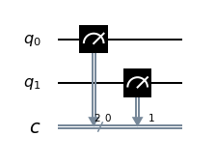
Correlation between Readout Error Rates of Qubits
Data from London Device (8096 shots)

Slide 10
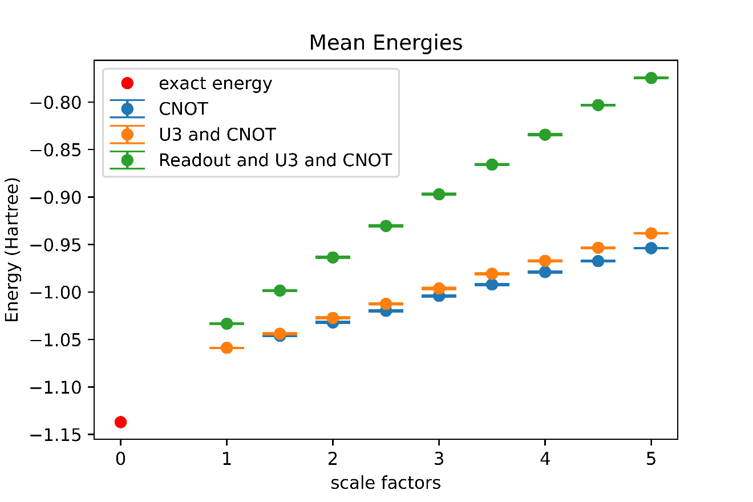
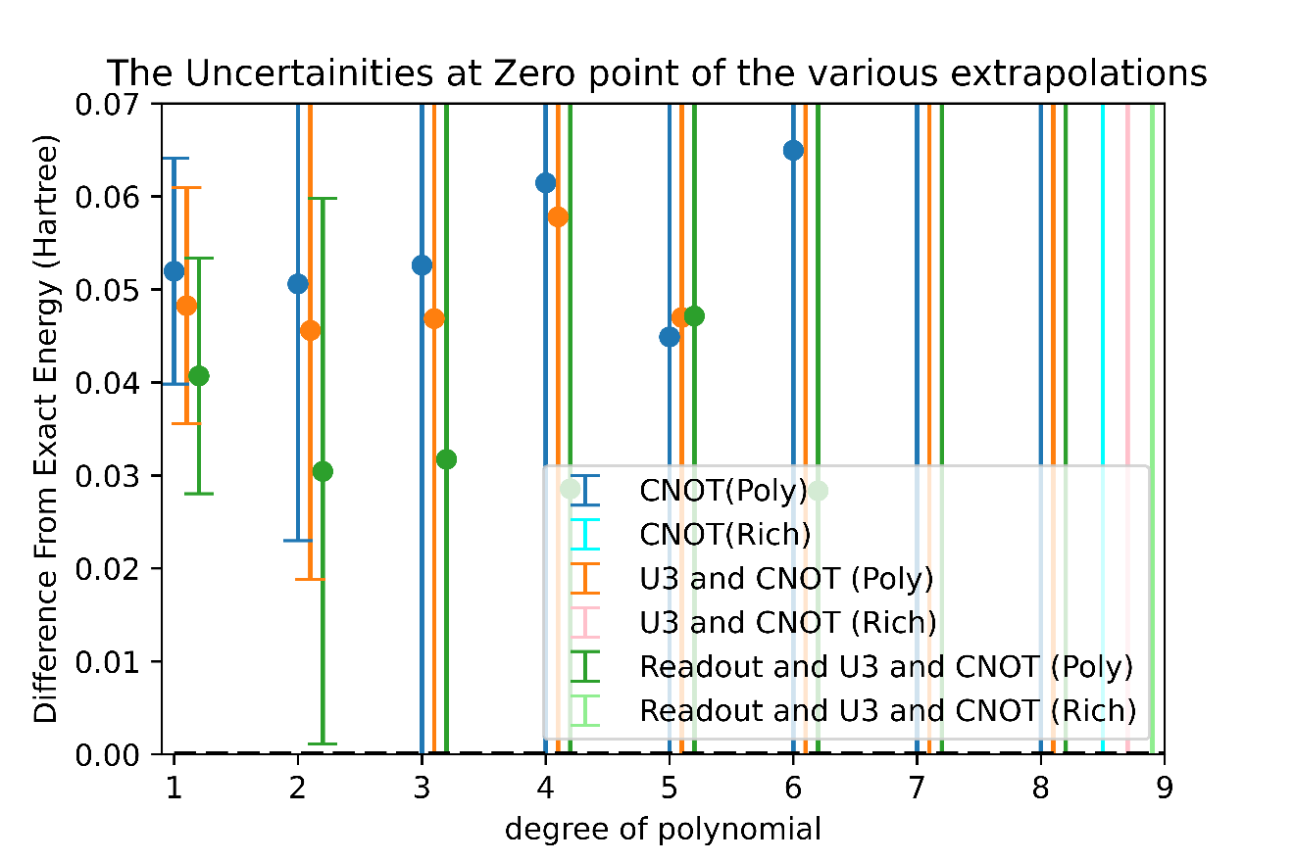
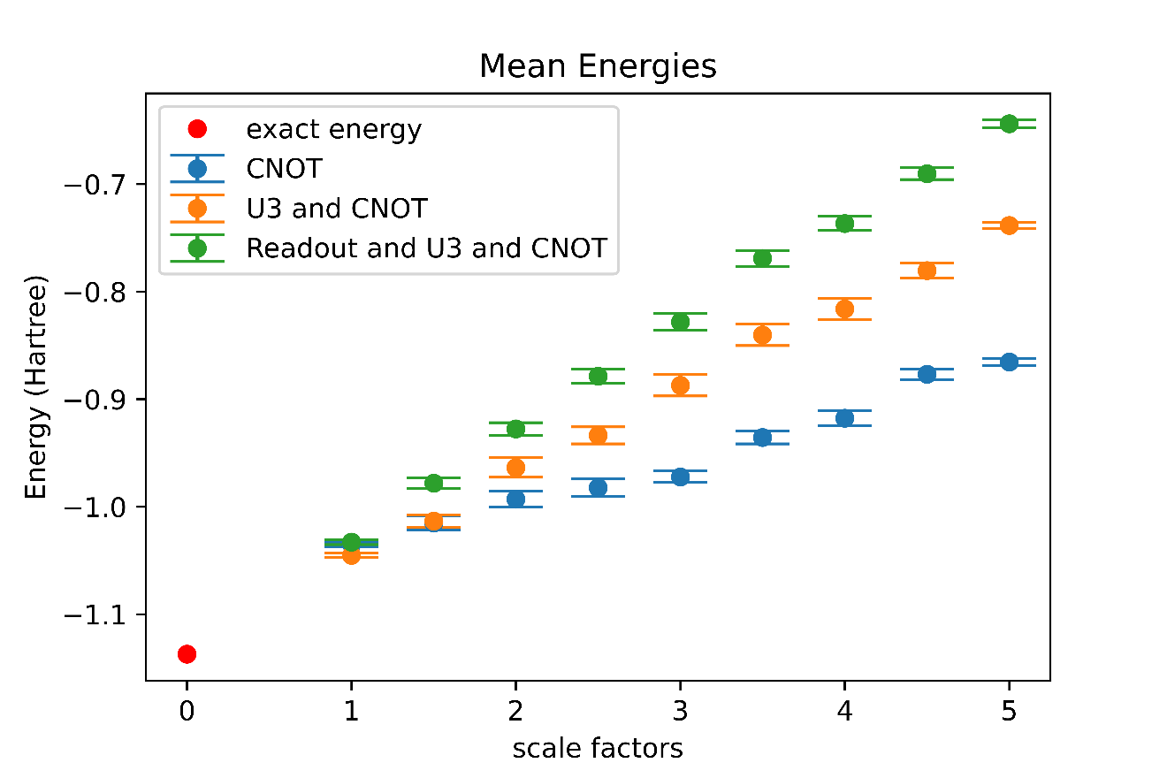
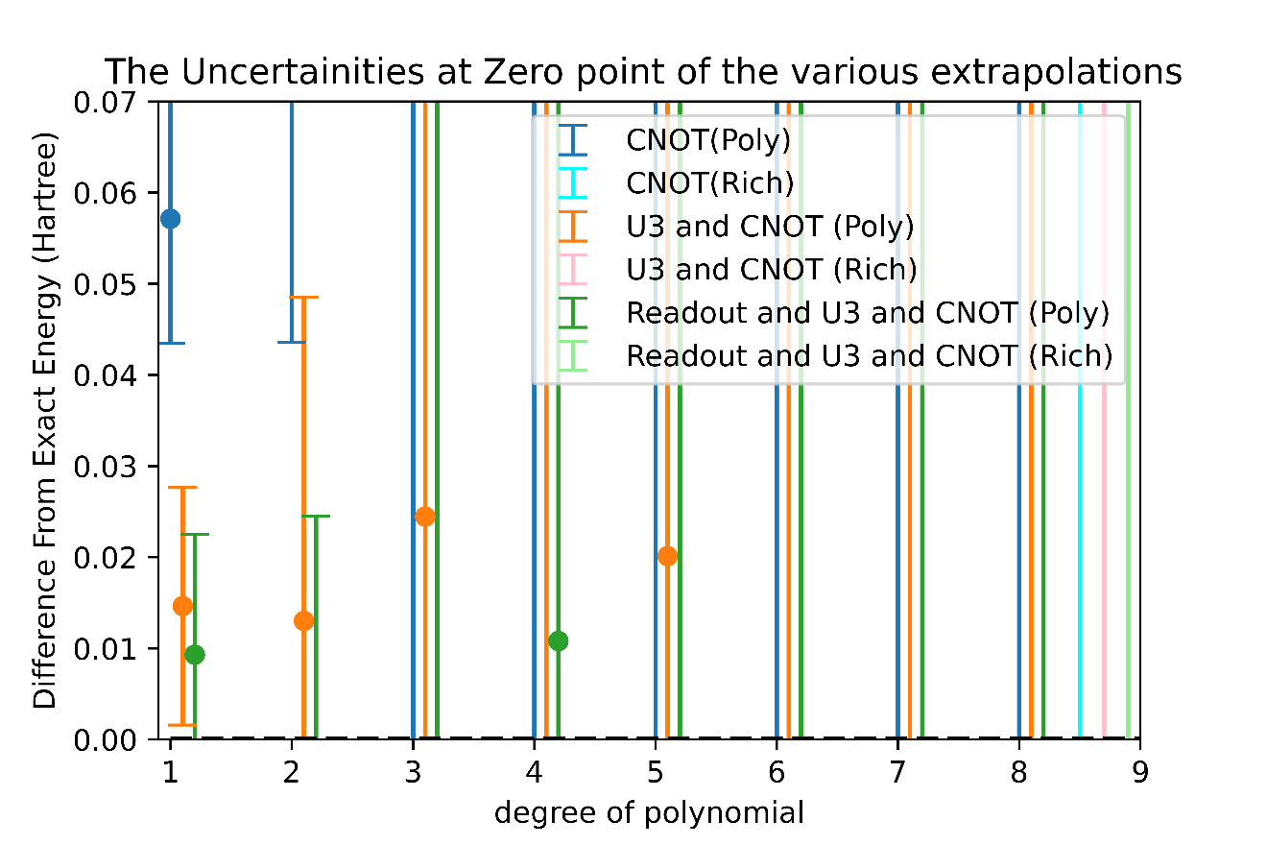
FakeLondon Noise Model
1000 samples
London Device
25 samples

